Slide 1
Study Abroad
…………………………….
Email: study_abroad@slc.co.uk

Slide 2
Information & Guidance Student Finance England
Charmaine Valente
Times:
10:30 – 10:40 introduction
10:40 – 11:30 Presentation
11:30 – 11:50 Q&A
11:50 - 12:00 Break
12:00 – 12:20 Information and Guidance
12:20 - 12:30 Final comments

Slide 3
STUDENT FINANCE APPLICATIONS
KEY MESSAGES – SFE APPLICATION DATES AY 2024/25
Students need to apply for funding for each year of their course and it is important to get applications submitted before (or at least close to) the ‘on time deadlines’:
The AY 2024/25 application service for
full-time SFE undergraduate students opened on March 13th 2024
The ‘deadline’ for new full-time SFE applications is May 17th 2024
(June 21st for continuing students)
i
Continuing students receive ‘Call to Action’ communications, prompting
them to reapply for their funding for the new academic year

Slide 4
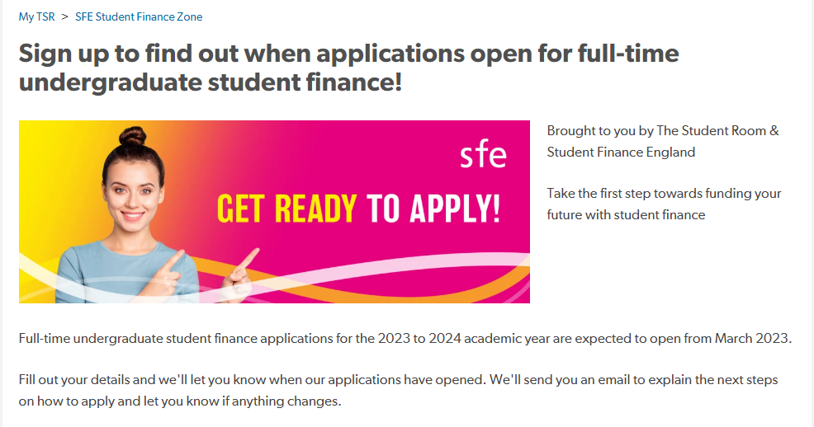
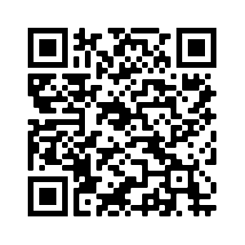
Where to sign post students
New Figures for 2024/25 (What You Can Get and What You Repay)
Tuition Fee Loans
Maintenance Loans
Disabled Students Allowance
Grants for Dependants
Postgraduate Loans
New Repayment Plan 5
SFE: https://www.gov.uk/apply-online-for-student-finance
SFW: https://www.studentfinancewales.co.uk/
Notes:
https://www.gov.uk/apply-online-for-student-finance

Slide 5
Tuition Fees – Study Abroad
Study Abroad for a full academic year as part of a UK course the fees are capped at 15%

Slide 6
Maintenance Loans – Which Tier?
Maximum (Maintenance) loan for living costs for new full-time students and eligible continuing fulltime 2016 cohort students:
Loan Rate | 2016 Cohort Full-Time Students | Entitled to Benefits | Aged Over 60 First Day of First AY
Parental Home | £8,610 | £10,158 | £4,327
Elsewhere | £10,227 | £11,658
London | £13,348 | £14,557
Overseas | £11,713 | £13,038
*Lower amounts available for final year students

Slide 7
Maintenance Loans – NMT, MT and Maximum
2016 cohort FT students, not eligible for benefits or aged over 60
Full Year Student* | Maximum Loan | Non-Income Assessed | Income Assessed
Parental Home | £8,610 | £3,790 | £4,820
Elsewhere | £10,227 | £4,767 | £5,460
London | £13,348 | £6,647 | £6,701
Overseas | £11,713 | £5,662 | £6,051
*Lower amounts available for final year students

Slide 8
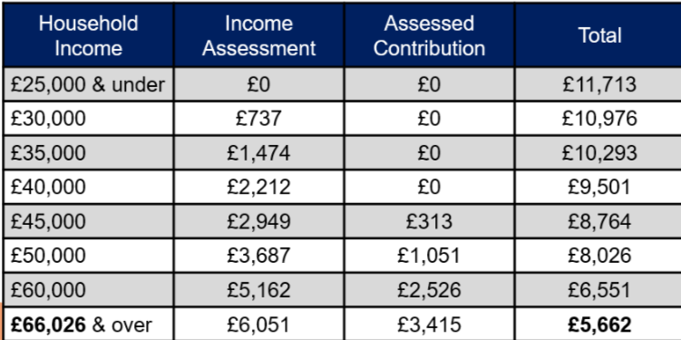
Maintenance Loans – Overseas Rate
2016 cohort FT students, not eligible for benefits or aged over 60

Slide 9
Disabled Students
The maximum allowance (£26,948) will apply to both full-time and part-time undergraduate and postgraduate DSA recipients in 2024/25. This replaced the four DSA allowances available in previous years.
For study Abroad students who require DSA, will need to check with the University where they intend to study abroad to have them put in place support with the assistance of the ‘Home’ university
Students in the UK are entitled for 2023/24 academic year up to £26,948. Student should check how they can access DSA support in the host country
Future work by Funding Informaiton Accoun Manager
Working with the SLC DSA team to review what DSA support for study abroad students

Slide 10
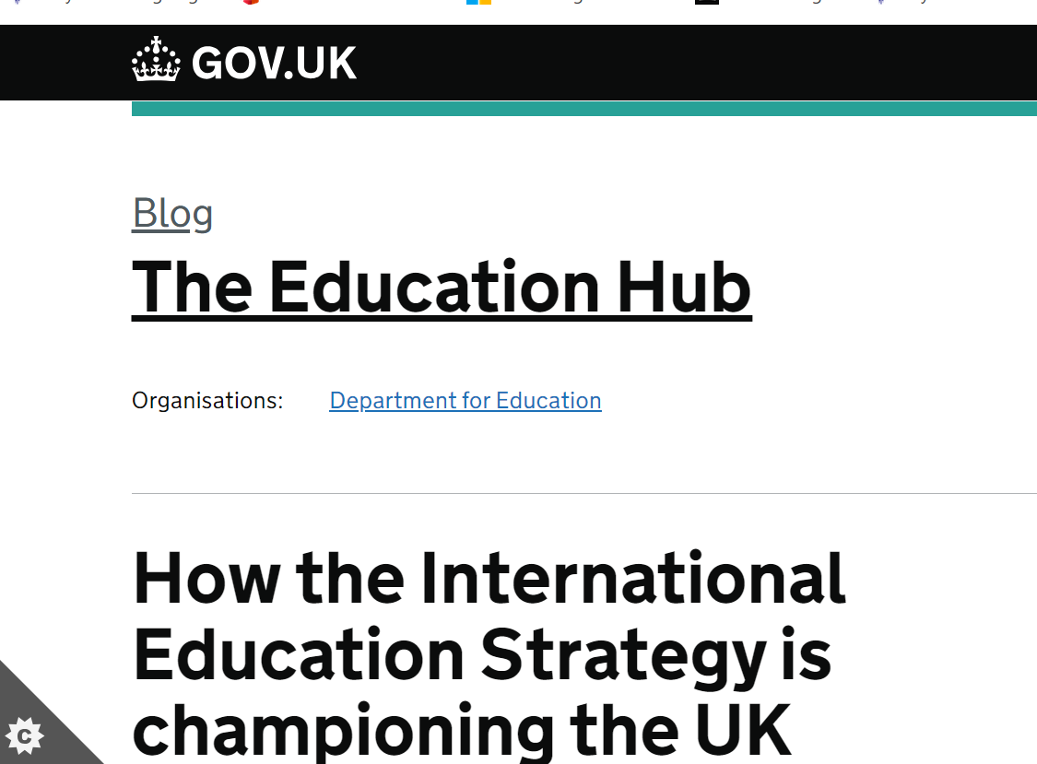
Turing Scheme
TAITH Scheme
https://educationhub.blog.gov.uk/2021/10/08/how-the-international-education-strategy-is-championing-the-uk-education-sector-overseas/
Notes:
Although Turing (England) and Taith (Wales) are both government funding, they sit separately to SLC and the funding is run through Capita. The main thing to inform student is in relation to double funding for travel.
Capita may not be running Turing in 2024/25 – awaiting further details

Slide 11
Lifelong Learning Entitlement
A New, Flexible Student Finance System
The Lifelong Learning Entitlement (LLE) will transform the post-18 student finance system in England:
LLE will create a single funding system to help people pay for college or university courses, and flexibly train, retrain and upskill
This new, unified system is called the Lifelong Learning Entitlement (LLE)
Under LLE, students will be able to apply for a loan worth the equivalent of four years of post-18 education (£37,000 in today’s tuition fees)
An additional entitlement, above the core four-year entitlement, will be made available for a limited number of priority subjects and longer courses
Apply for January 2026 courses start dates

Slide 12
Lifelong Learning Entitlement
A New, Flexible Student Finance System
Through the LLE there will be increased flexibility for learners in how they choose to study, broadening access to funding for eligible modules, not just full courses:
Ensuring module quality:
Modules must be from a single ‘parent course’ that can be stacked towards full qualifications
Modules must be credit bearing, with a 30-credit minimum, which can be achieved by ‘bundling’
Modules must have a single assigned academic level i.e. Level 4
Learners will receive a standardised transcript on completion

Slide 13
Lifelong Learning Entitlement
A New, Flexible Student Finance System
The government has decided to phase the delivery of the LLE during AY 2025/26.
This will mean that the first LLE learners will apply for their funding in September 2025 (instead of February 2025) and commence study of their courses and modules from January 2026 (instead of September 2025).
Lifelong Learning Entitlement overview - GOV.UK (www.gov.uk)

Slide 14
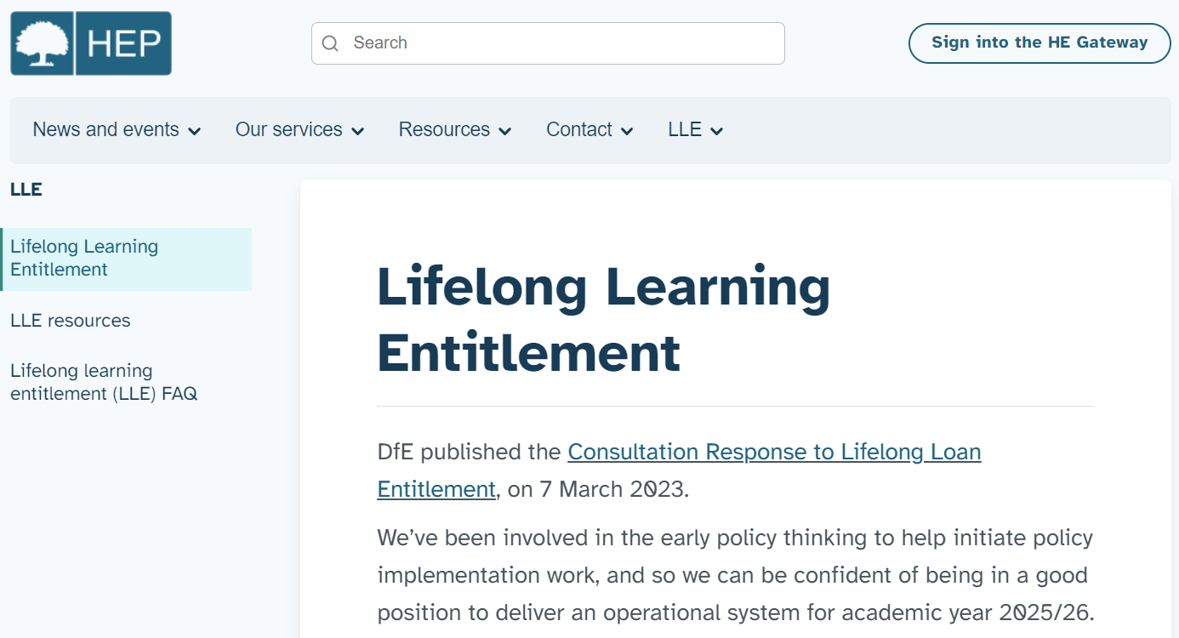
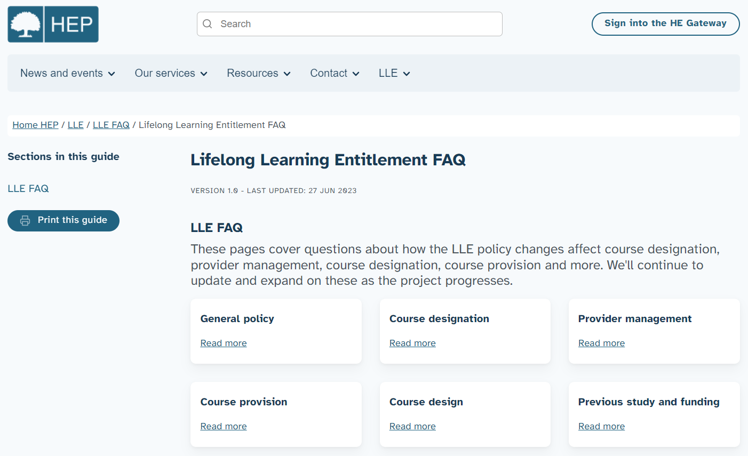
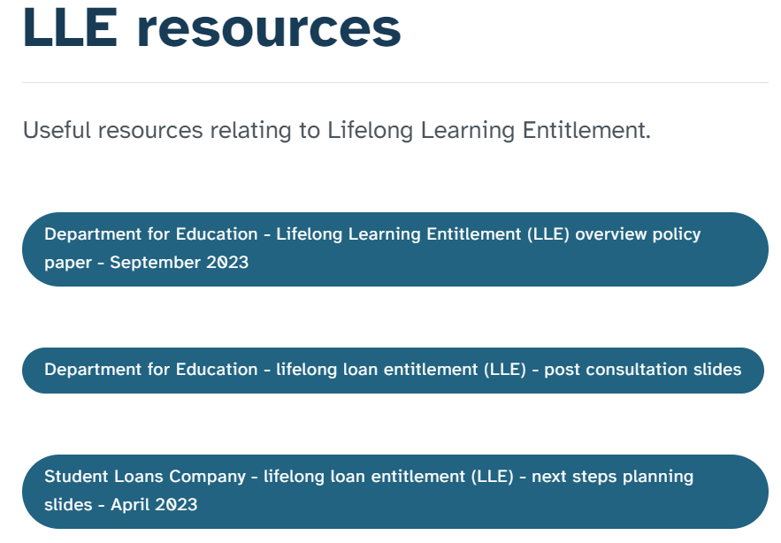
Lifelong Learning Entitlement
A New, Flexible Student Finance System
Dedicated information sections have been added to the HEP Services and LP Services websites and will host the latest LLE updates and resources:
www.heinfo.slc.co.uk/lle/lifelong-learning-entitlement
www.lpservices.slc.co.uk/lle/lifelong-learning-entitlement
Page content includes an LLE introduction, LLE resources and exclusive to the HEP Services website, an LLE frequently asked questions (FAQ) section

Slide 15
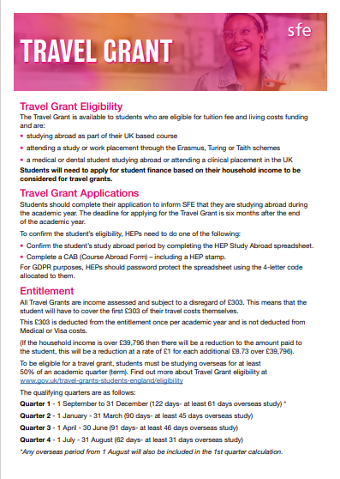
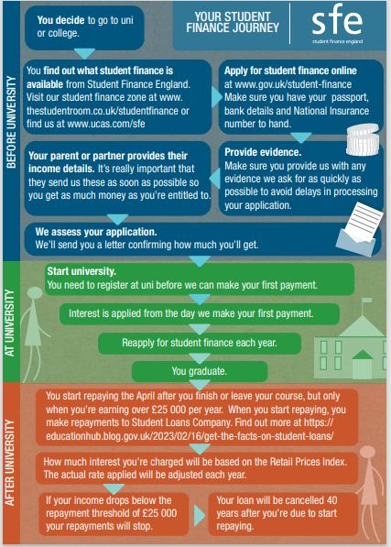
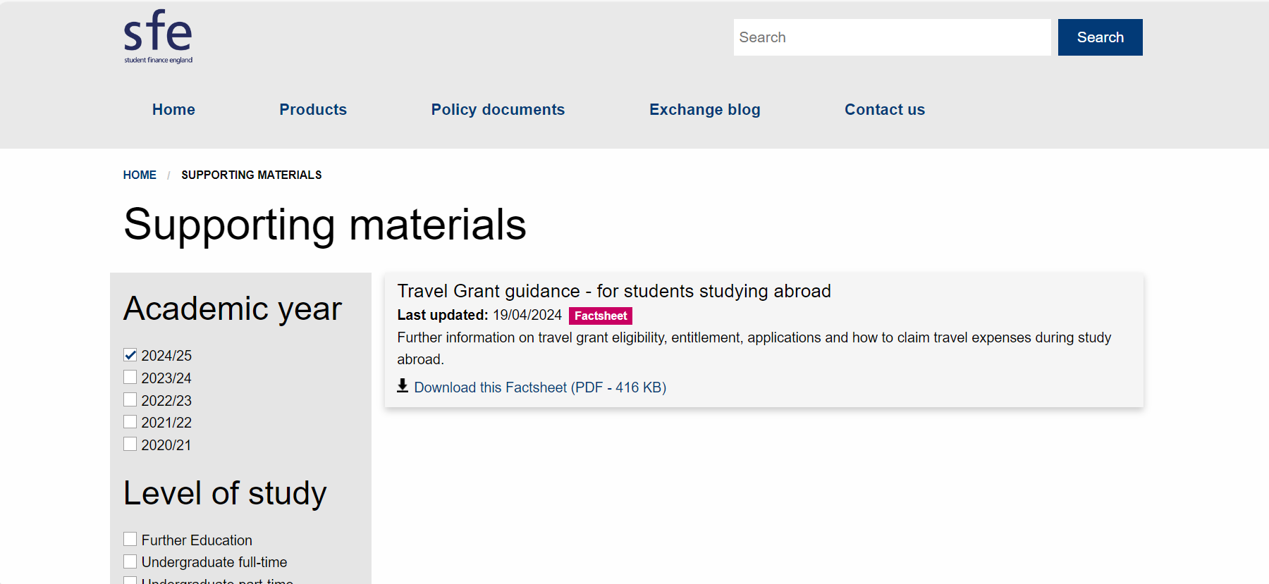
Resources
We have recently updated our resources for AY 23/24, some examples of the leaflets we have available:
https://www.practitioners.slc.co.uk/supporting-materials/
Notes:
Soon to be added to our SFE and SFW practitioner sites for the student journey

Slide 16
Travel Grants
You can now direct any queries regarding travel grants to our travel grant team.
The travel grant team have also created a document which should help you understand how travel grant claims work and what is required. This will be included in the study abroad bulk email to be sent with the HEP confirmation sheet.
EMAIL : TRAVEL_GRANT_QUERY@SLC.CO.UK

Slide 17
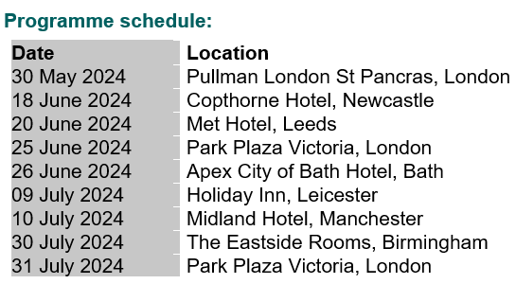
SAVE THE DATE - UPDATE Lifelong Learning Entitlement Planning & Awareness Programme
Who should attend? We would encourage planners, course designers, IAG practitioners and student advice staff to consider this programme to be critical, in preparing for the implementation of the LLE student finance system.
We are planning to open registration for this programme w/c 29th April 2024. Look out for our registration opening notice.

Slide 18
Question time
Email: study_abroad@slc.co.uk

